Slide 1
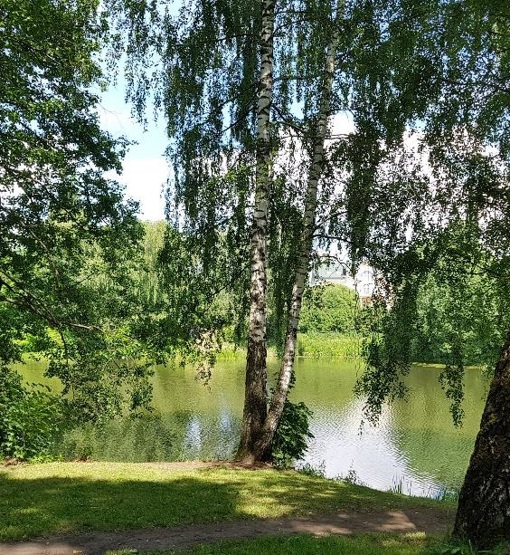
THE STUDY OF THE LICHEN BIOTA OF OLD-WORLD PARKS IN THE MOSCOW REGION
Cherepenina D.A., Muchnik E.E.
Institute of Forest Science, Russian Academy of Sciences

Slide 2
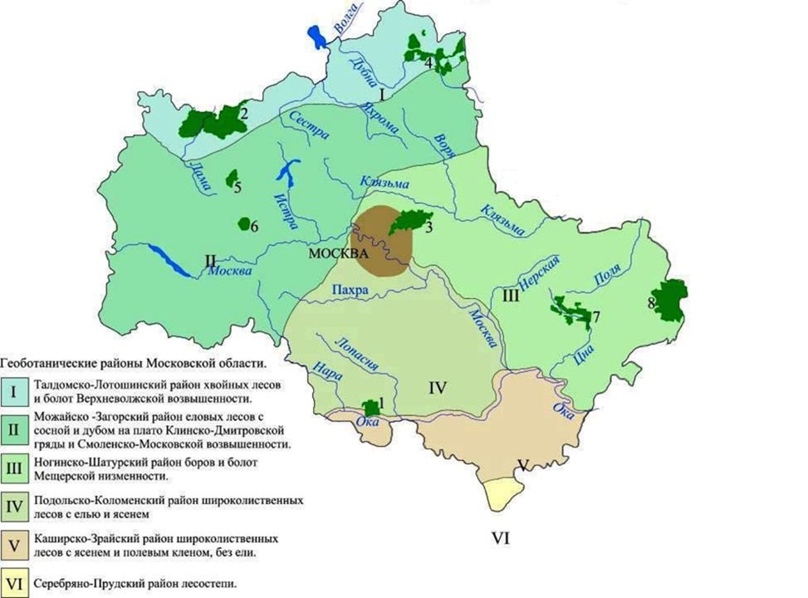
MR «Abramtsevo»
MR of A.S. Pushkin
ME «Ostafyevo»
2

Slide 3
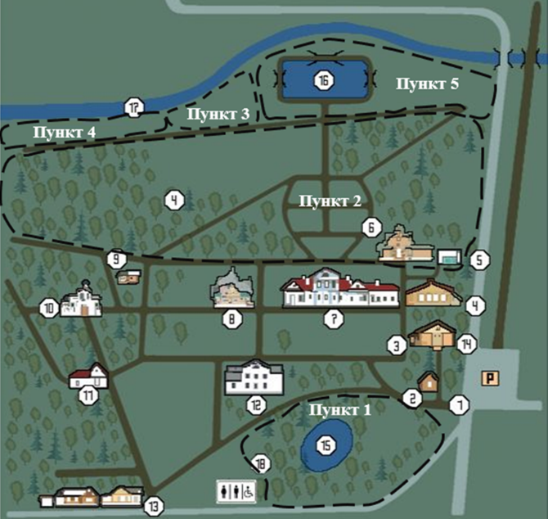
Sergiev Posad district of
Moscow Oblast
Area about 50 hectares
Regular park of the XVIII century
P. 1 − plantings around the Upper pond.
P. 2 − linden alleys behind the manor house, slope to the river Vorya.
P. 3 − bank of the river Vorya, riverside planting of oak, maple.
P. 4 − plantings along the bank of the river Vorya.
P. 5 − plantings around the Lower pond, near the automobile road.
The map of the museum-reserve "Abramtsevo"
with collection points

Slide 4
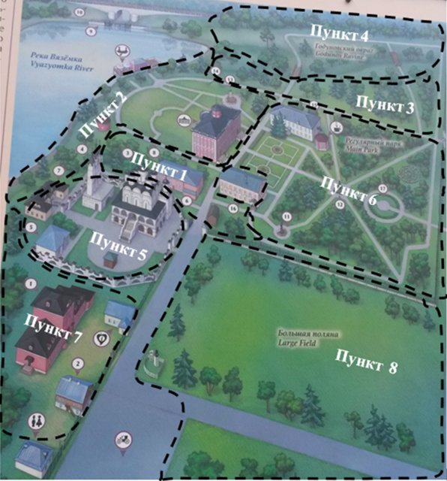
Odintsovsky district of Moscow Oblast
The total area of ​​the two estates
32 hectares
Regular park of the XVIII century
P. 1 − near the entrance to the park near the church.
P. 2 − near the dam on the Vyazemka river.
P. 3 − east of the dam on the Vyazemka river, opposite the automobile road.
P. 4 − plantings near the automobile road in the area of ​​the Godunovsky gulley.
P. 5 − plantings around the Church of the Transfiguration (the Life-Giving Trinity).
P. 6 − Regular park.
P. 7 − plantings around the stable yard.
P. 8 − Large field.
The map of the museum-reserve of A.S. Pushkin (Vyazemy estate) with collection points

Slide 5
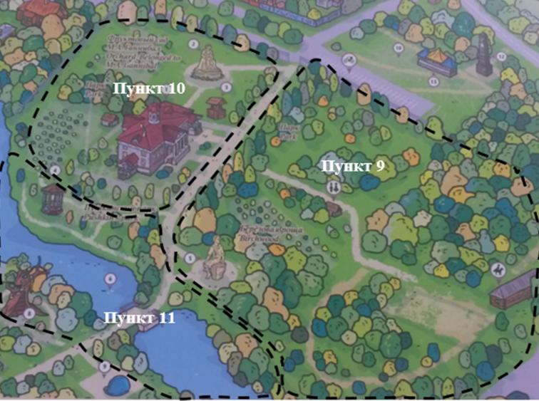
P. 1 − Park.
P. 2 − fruit grove.
P. 3 − near the manor pond.
The map of the museum-reserve of A.S. Pushkin (Zakharovo estate) with collection points

Slide 6
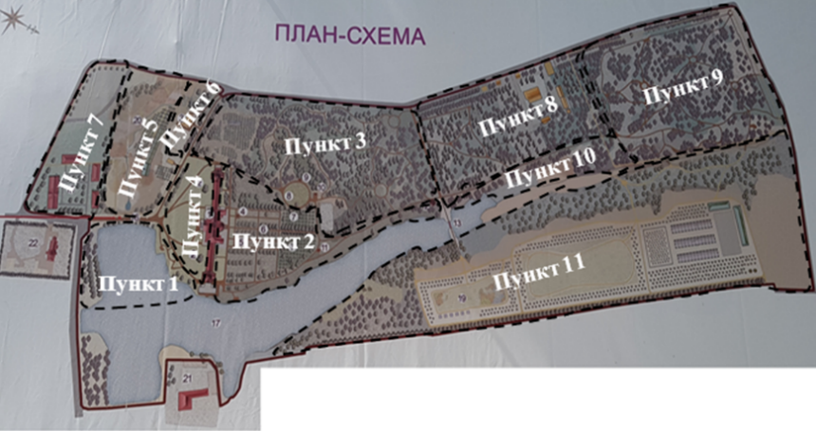
Novomoskovsk administrative district of Moscow
Regular park of
the XVIII century
The map of the
museum-estate
"Ostafyevo" − "Russian Parnassus"
with collection points
Area about 40 hectares
P. 1 − in front of the main house, near the Big pond.
P. 2 − behind the main house, the linden alley "Russian Parnassus", near the Big pond.
P. 3 − to the left of the Field of Mars and behind it.
P. 4 − plantings in front of the main house.
P. 5 − floodplain of the Lobuchi river.
P. 6 − around the medal cabinet.
P. 7 − near the building of the former cloth factory.
P. 8 − coniferous grove.
P. 9 − birch Karamzin grove.
P. 10 − planting along the bank of the Big pond, Dorsky stream, behind the arbor "Temple of Apollo".
P. 11 − on the right bank of the Big pond.

Slide 7
RESULTS
Quantitative distribution of lichen species in the surveyed territories
Park communities | Number of lichen species | Number of genera | Number of families
MR "Abramtsevo" | 55 | 30 | 17
MR of A.S. Pushkin | 58 | 36 | 18
ME "Ostafyevo" | 68 | 41 | 22
Total: | 102 | 49 | 25
7

Slide 8
Spectrum of the leading families of the lichen biota in the surveyed territories in general
8

Slide 9
Spectra of ecobiomorphs of the lichen biotas of the parks of the surveyed territories
9

Slide 10
Spectra of ecological-substrate groups of the lichen biotas of the parks of the surveyed territories
10

Slide 11
The distribution of the lichen species in relation to the pH of the forrophytes bark in the surveyed territories
11

Slide 12
Quantitative distribution of acidophytes in the lichen cover of oak in the surveyed territories
Park communities | Amount of acidophytes, %
MR "Abramtsevo" | 38,1
MR of A.S. Pushkin | 13,3
ME "Ostafyevo" | 18,2
Scale of nitrogen pollution (Е.Е. Muchnik, 2017):
1) no or minor/low pollution (at least 75% of acidophytes);
2) moderate pollution (no less than 50%);
3) significant pollution (at least 25%);
4) acute pollution (less than 25%).

Slide 13
Ratios of the specificity of the species composition for various types of substrates of the studied lichen biota
Forrophyte | a | b | k
Birch | 11 | 56 | 19,6
Linden | 6 | 53 | 11,3
Oak | 4 | 34 | 11,8
Pine | 3 | 24 | 12,5
Maple | 3 | 23 | 13,0
Aspen | 1 | 21 | 4,8
Ratios of the specificity of the species composition for various types of substrates: k = (a/b)*100;
a − the number of species found exclusively on this type of substrate;
b − total number of species found on it.

Slide 14
Similarity matrix of the lichen biotas of the parks of the surveyed territories
Ksc и с | MR "Abramtsevo" | MR of A.S. Pushkin | ME "Ostafyevo"
MR "Abramtsevo" | − | 0,51 | 0,57
MR of A.S. Pushkin | 29 | − | 0,62
ME "Ostafyevo" | 35 | 39 | −
Similarity coefficient of Sørensen: Ksc=2c/(a+b);
a − number of species in one park;
b − number of species in another park;
c − number of total species for two parks.
14

Slide 15
Ratios of the specificity of the surveyed parks
Parks | a | b | K
MR "Abramtsevo" | 15 | 102 | 14,7
MR of A.S. Pushkin | 14 |  | 13,7
ME "Ostafyevo" | 18 |  | 17,6
Ratios of the specificity: K = (a/b)*100;
a − number of species found only in one of the surveyed parks;
b − total number of species found in all surveyed parks.
15

Slide 16
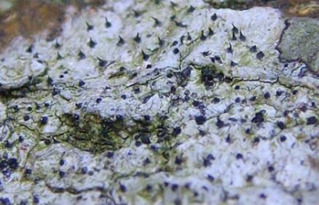
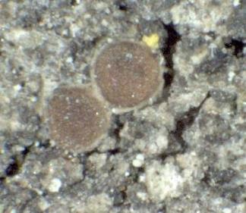
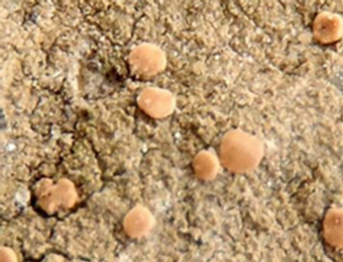
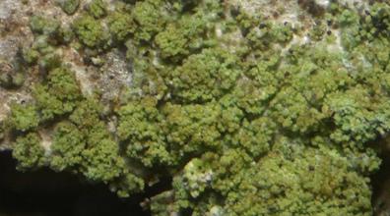
SPECIES NEW FOR THE MOSCOW REGION
Anisomeridium polypori
(Ellis & Everh.) M.E. Barr
Bacidina chloroticula
(Nyl.) A.L. Sm.
Caloplaca obscurella
(J. Lahm ex Körb.) Th. Fr.
Fuscidea arboricola
Coppins et Tønsberg
16

Slide 17
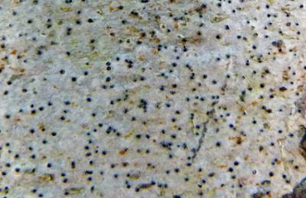
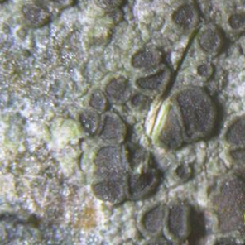
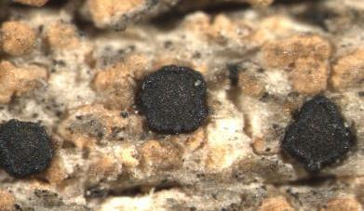
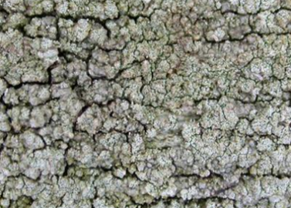
Pycnora praestabilis
(Nyl.) Hafellner
Mycomicrothelia confusa
D. Hawksw.
Myriolecis persimilis
(Th. Fr.) Śliwa, Zhao Xin & Lumbsch
Violella fucata
(Stirt.) T. Sprib.
17

Slide 18
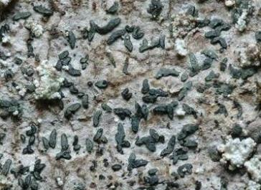
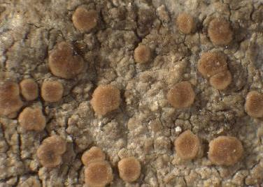
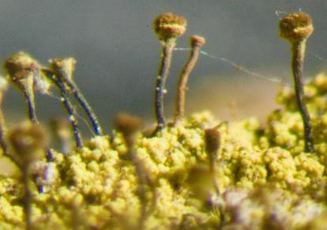
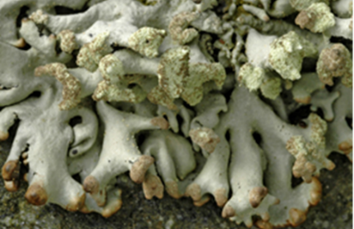
SPECIES TYPICAL FOR FOREST ECOLOGY
Alyxoria varia
(Pers.) Ertz & Tehler
Biatora helvola
Körb. ex Hellb.
Chaenotheca chrysocephala
(Turner ex Ach.) Th. Fr.
Hypogymnia tubulosa
(Schaer.) Hav.
18

Slide 19
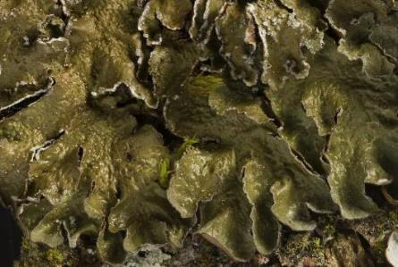
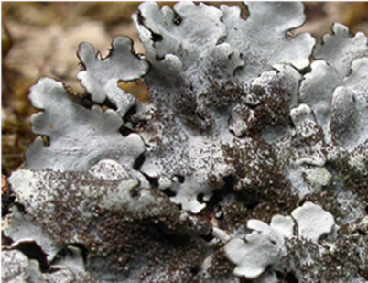
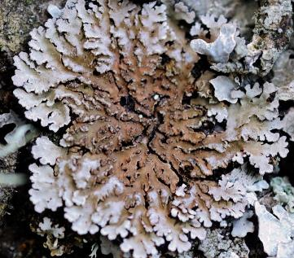
INDICATORS OF OLD-WORLD AND WELL-PRESERVED PARK COMMUNITIES
Melanelixia subargentifera
(Nyl.) O. Blanco et al.
Parmelina tiliacea
(Hoffm.) Hale
Physconia perisidiosa
(Erichsen) Moberg
19

Slide 20
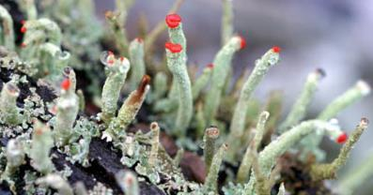
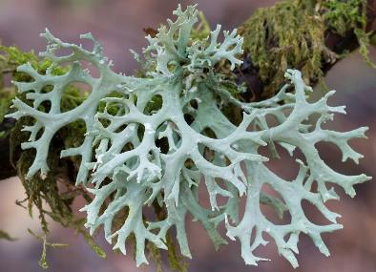
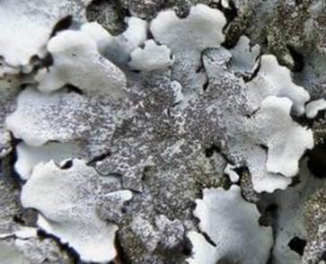
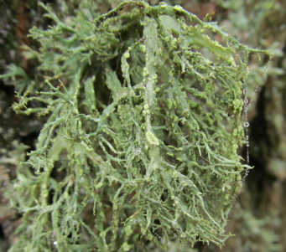
RARE SPECIES LISTED IN THE RED BOOKS OF MOSCOW (RBM) AND MOSCOW OBLAST (RBMO)
Cladonia macilenta Hoffm.
RBM 2
Evernia prunastri (L.) Ach.
RBM 3
Parmelina tiliacea (Hoffm.) Hale
RBMO 2
Ramalina farinacea (L.) Ach.
RBMO 3
RBM: 2 − rare species; 3 − vulnerable species;
RBMO: 2 − abbreviated species; 3 − rare species
20

Slide 21
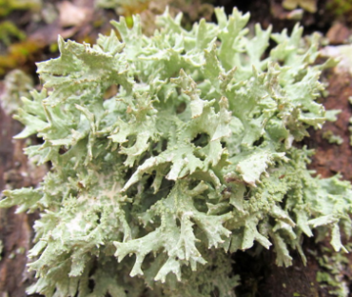
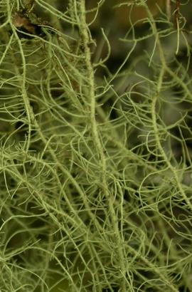
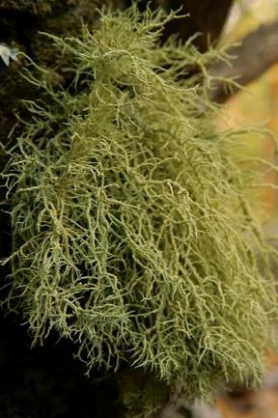
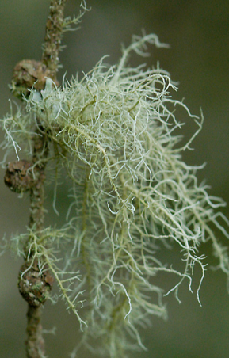
Ramalina pollinaria (Westr.) Ach.
RBM 1; RBMO 2
Usnea dasypoga (Ach.) Shirley
RBMO 3
Usnea hirta
(L.) Weber ex F.H. Wigg.
RBM 1; RBMO 3
Usnea subfloridana Stirt. RBMO 3
RBM: 1 − endangered species;
RBMO: 2 − abbreviated species; 3 − rare species
21

Slide 22
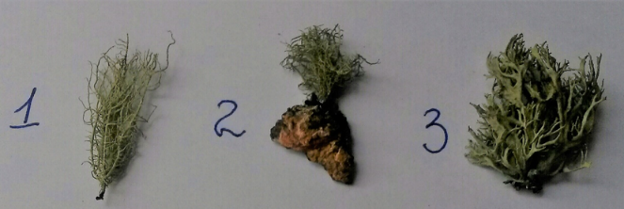
1 – Usnea dasypoga
2 – Usnea subfloridana
3 – Ramalina farinacea
Almost all the rare species have a small thallus and poor vitality (underdevelopment of vegetative propagules).
22

Slide 23
CONCLUSIONS
The state of the lichen biotas of the parks of the museum-reserve "Abramtsevo" and the museum-estate "Ostafyevo" − "Russian Parnassus" is characterized as the best, with an insignificant level of anthropogenic transformation, and that of the museum-reserve of A.S. Pushkin − as good, with a low level of anthropogenic transformation;
The low representation of acidophytes in the lichen cover of oak as well as the slow growth of thallus and the poor vitality of rare species indicate the changes of environmental parameters in all the parks compared to natural forest communities;
The changes are caused by pollution (including nitrogen) and dusty air, as the studied territories are surrounded by automobile roads and are located in areas with moderate and very high degrees of anthropogenic load.
23

Slide 24
БЛАГОДАРНОСТИ
Администрациям музеев-заповедников «Абрамцево», А.С. Пушкина и музея-усадьбы «Остафьево» − «Русский Парнас» за содействие в организации исследований;
Коллегам к.г.н. Г.П. Урбанавичюсу (Институт проблем промышленной экологии Севера КНЦ РАН), д.б.н. М. Кукве (Гданьский университет), к.б.н. И.Н. Урбанавичене и к.б.н. Л.А. Коноревой (Ботанический институт им. В.Л. Комарова РАН) за помощь в определении и подтверждении некоторых видов лишайников;
Коллегам к.б.н. А.Г. Паукову (Уральский федеральный университет им. Б.Н. Ельцина) и к.б.н. А.Г. Цурикову (Гомельский государственный университет им. Ф. Скорины) за проведение химического анализа образцов лишайников для определения их видовой принадлежности.
24

Slide 25
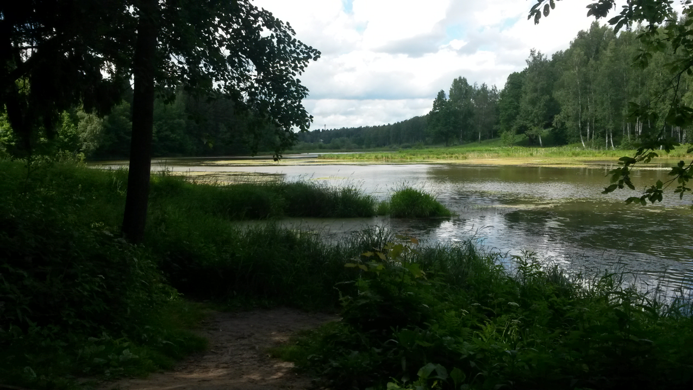
THANKS FOR YOUR ATTENTION

