Slide 1
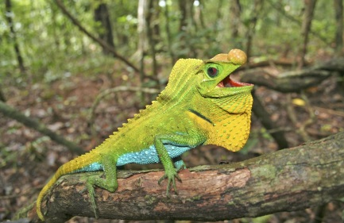
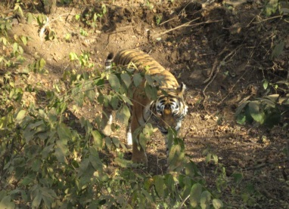
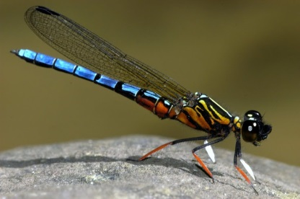
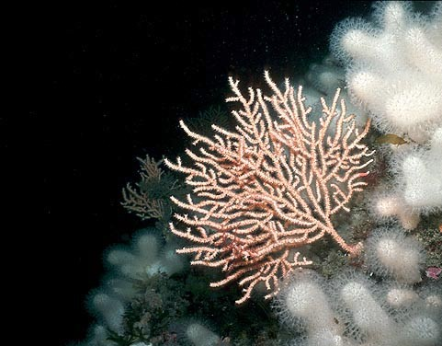
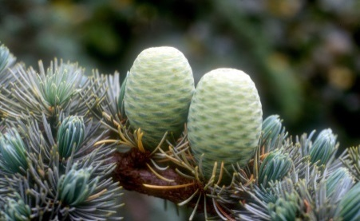


The importance of Regional Red Lists for conservation:
from assessments to action
Monika Böhm
Indicators & Assessments Unit
www.nationalredlist.org
monika.bohm@ioz.ac.uk
Notes:
Representing the IUCN as a Red List Partner organisation (involved in the assessment process for the Sampled Red List Index, coordinating the project) as well as the National Red List Alliance which is a body established in 2013 to promote and drive forward the national red listing process globally. This was in response to result 2 in the IUCN Red List of Threatened Species Strategic Plan (2013-2020): more IUCN Red List assessments are prepared at national and, where appropriate, at regional scales.
What I will be talking about: why do we need to measure species status, what is the IUCN and what does the IUCN Red List do, why are National Red Lists important, why is it important that they are standardised, and I will try and link this as much as possible into why ZSL is involved in this work so you can understand our involvement as a Red List partner.
The Zoological Society of London (ZSL) was founded in 1826 and is a world-renowned
centre of excellence for conservation science and applied conservation. The society’s
mission is to promote and achieve the worldwide conservation of animals and their
habitats. This is realised by carrying out field conservation and research in over 80
countries across the globe, much of which is integrated with academic research via ZSL’s Institute of Zoology

Slide 2


The IUCN – brief intro!
IUCN
Created in 1948
>1,000 member organizations
• >80 States
• >100 Government agencies
• >800 NGOs
>1,000 staff (including Regional Offices)
10,000 Commission members (scientists and experts)
~5,000 representatives from partner organizations
Many experts that are not Commission members
Official observer to the UN General Assembly
Members
Commissions
Secretariat
In 160+ countries
Partners
Non-Commission
Experts
Notes:
I will be talking a lot about the IUCN Red List and the IUCN Categories and Criteria by which we can assess species status. The IUCN Red List is compiled and managed by IUCN so to start off with, I shall give you a very brief introduction of what the IUCN is.
IUCN is one of the oldest and largest international conservation networks. It was formed in 1948, and has been creating Red Data Books and Red Lists for more than 60 years, though the Union also works on other issues related to the conservation of nature in addition to species work. IUCN is made up of >1,000 Member organizations (including States, governmental organizations and NGOs), >1,000 staff located all around the world, and 10,000 scientists and experts that form the different IUCN commissions. Of the six Commissions, the Species Survival Commission is the largest and works directly with the production of the IUCN Red List.

Slide 3
IUCN species work
SSC Chair
IUCN Secretariat
IUCN Global Species Programme
SSC Steering Committee
Biodiversity Assessment Unit
FW Biodiversity Unit
Marine Biodiversity Unit
Red List Unit
Species Information Service
SSC Network Support
Climate Change
Species Trade & Use
>7,500 volunteer experts in 100+ Specialist Groups and Task Forces
IUCN Species Survival Commission
Notes:
The Species Survival Commission (or SSC) consists of thousands of volunteer members: experts and specialists located all over the world. The SSC membership is grouped into Specialist Groups, each with a taxonomic or a regional focus. These experts provide the knowledge and data that go onto the Red List and work closely with the IUCN Red List Unit to review Red List assessments.
The SSC is headed by a Chair and its work is guided by a Steering Committee. The work of the SSC receives technical support from the IUCN Global Species Programme.
The Global Species Programme consists of several thematic units, including the Red List Unit and units focusing on other species conservation-related issues, such as climate change, trade and use, and issues specific to freshwater and marine systems.

Slide 4
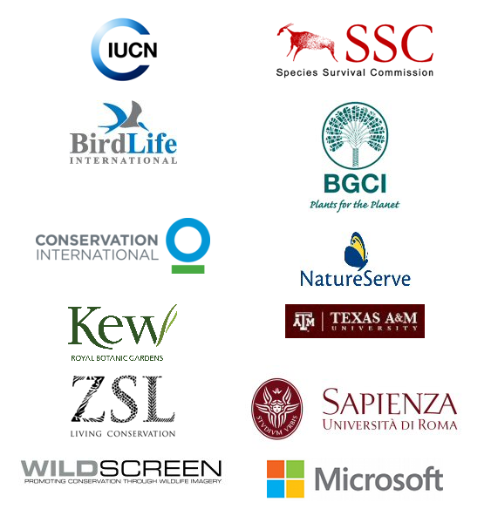
Red List Partnership
Notes:
How does ZSL fit into this? As I already mentioned, ZSL is one of a list of IUCN Red List partner organisations, which means that we are supporting the Red Listing process, either by running some of the assessments (for example at ZSL we coordinate a project called the Sampled Red List Index, which includes coordinating a large number of species assessments for primarily invertebrate groups) or by providing other support and resources (e.g. ArkIve is providing some of the imagery used on the IUCN Red List).

Slide 5
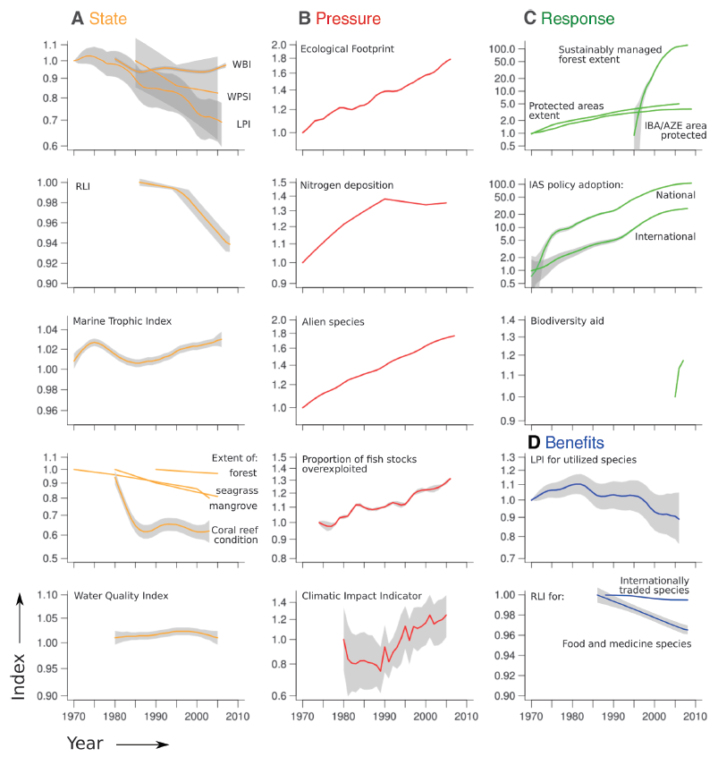
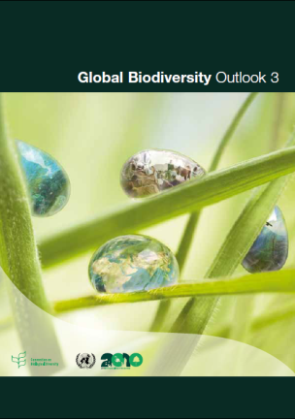
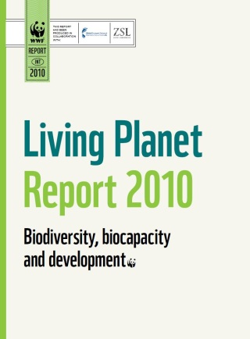
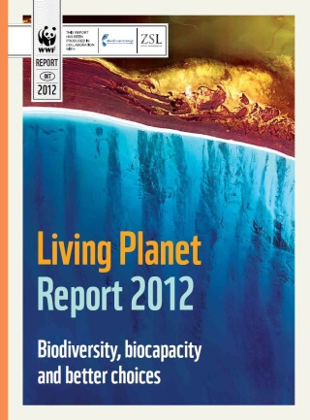
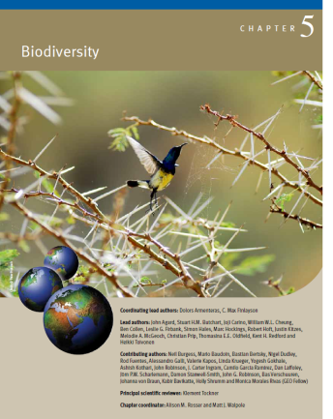
The motivation: biodiversity in crisis
Butchart, Walpole, Collen, et al. 2010 Science; Walpole et al. 2009 Science
Notes:
So what is our motivation behind working with the IUCN on Red Listing and related issues? Biodiversity continues to decline as has been shown in a 2010 publication based on 31 indicators to track progress towards the 2010 target of achieving a significant reduction in the rate of biodiversity loss. Most indicators of the state of biodiversity (covering species’ population trends, extinction risk, habitat extent and condition, and community composition) showed declines, with no significant recent reductions in rate, whereas indicators of pressures on biodiversity (including pressures such as invasive alien species, overexploitation, and climate change impacts) showed increases. Some local successes and increasing responses (including extent and biodiversity coverage of protected areas, sustainable forest management, policy responses to invasive alien species, and biodiversity-related aid), the rate of biodiversity loss does not appear to be slowing.

Slide 6

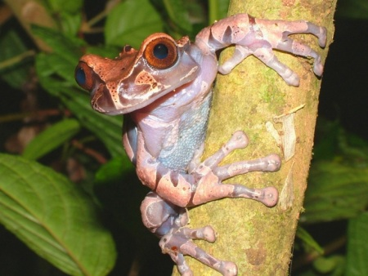
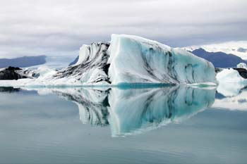
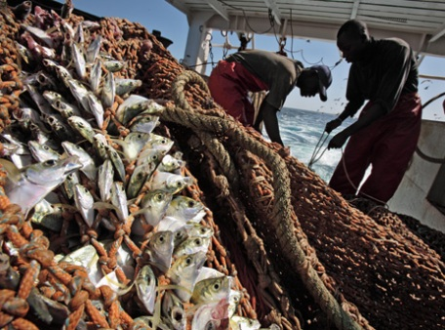
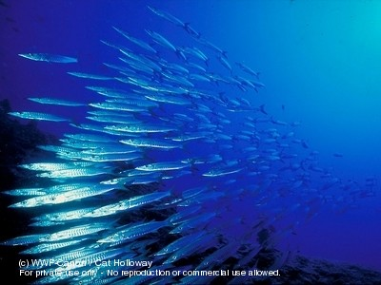
Global commitment to biodiversity
  CBD Strategic Plan for Biodiversity 2011-2020
  VISION: a world “Living in harmony with nature” where “By 2050, biodiversity is valued, conserved, restored and wisely used, maintaining ecosystem services, sustaining a healthy planet and delivering benefits essential for all people”.
  INCLUDES: Aichi Biodiversity Targets
    20 strategic targets under five goals
Notes:
As a result, the CBD has drawn up the Strategic Plan for Biodiversity 2011-2020

Slide 7
The biodiversity crisis
Goal A | Address the underlying causes of biodiversity loss by mainstreaming biodiversity across government and society
Goal B | Reduce the direct pressures on biodiversity and promote sustainable use
Goal C | Improve the status of biodiversity by safeguarding ecosystems, species and genetic diversity
Goal D | Enhance the benefits to all from biodiversity and ecosystem services
Goal E | Enhance implementation through participatory planning, knowledge management and capacity building
20 targets
Notes:
194 parties signed up to meet these targets and made progress towards these goals by 2020

Slide 8
Keeping track of biodiversity
e.g.
Extinction risk of species
Population trends
Butchart, Walpole, Collen, et al. 2010 Science; Walpole et al. 2009 Science
Notes:
To measure progress towards these targets, we need to monitor the status of biodiversity and trends over time, as is already underway – for example as we have seen in the figure from the 2010 paper. What measures can we use to keep track of biodiversity – two in the figure on the left are extinction risk of species and population trends – these are two areas that we are working on at ZSL – Living Planet Index and the Sampled Red List Index, so we are working as a Red List partner to the IUCN to develop the indicator to track changes over time. By assessing species based on the IUCN Red List Categories and Criteria.

Slide 9

The IUCN Red List Index
Worse Red List Index Better
Year
Notes:
Examples of global Red List indices which are based on IUCN Red List Categories and Criteria, showing trends over time in extinction risk status. All declining in status, amphibians are worst off, corals have seen dramatic declines…

Slide 10
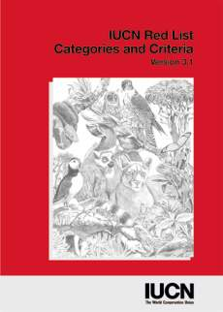

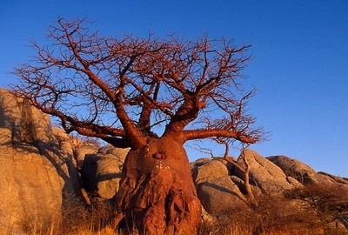
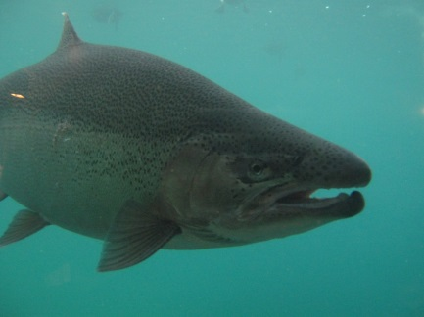


The IUCN Red List
  most comprehensive information source for extinction risk of species
  provides an explicit, objective framework for the classification of the broadest range of species according to their extinction risk
Notes:
So the IUCN Red List provides a powerful tool to help us track species status over time, why is this possible? Because the IUCN Red List is a) the most comprehensive information source for extinction risk of species and b) provides an explicit, objective framework for the classification of the broadest range of species according to their extinction risk.
Hence it provides a framework to assess a wide range of species under common standards to make assessments comparable across a scale of increasing relative extinction risk.

Slide 11
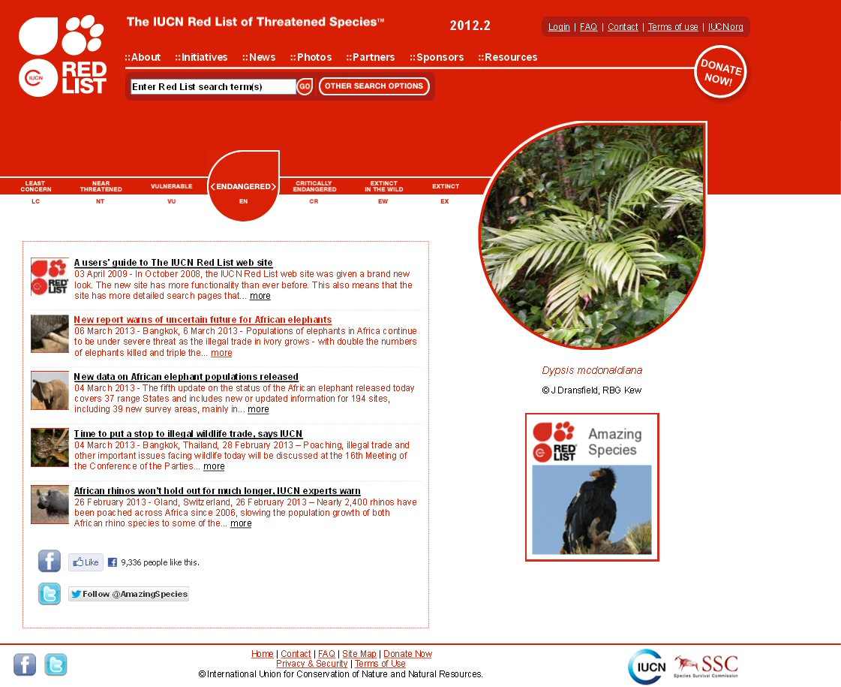
The IUCN Red List
Not just a list, but a compilation of the status of species at the global level:
  threats (e.g. invasive species), ecological requirements, and conservation actions
Based on the best scientific information available
Widely used to inform and influence biodiversity conservation
Based on five criteria which are used to estimate extinction risk of species
Notes:
What is the IUCN Red List?

Slide 12
The IUCN Red List
Global-scale assessments of species
Extinct (EX)
Extinct in the Wild (EW)
Critically Endangered (CR) (CR)
Increasing extinction risk
Endangered (EN)
Vulnerable (VU)
Near Threatened (NT)
Least Concern (LC)
Data Deficient (DD)
Not Evaluated (NE)
IUCN Red List Categories & Criteria
Currently: 74,106 species (v. 2014.2)
Notes:
A system of categories which correspond to increasing extinction risk of a species. And the five criteria give threshold values based on certain characteristics such as population reduction, restricted range size, small population sizes etc to place species in the three threatened categories, which are Vulnerable, Endangered and Vulnerable. Least Concern – used for species which have large populations, large ranges, no threats, or are in decline but not significantly enough to warrant a higher listing yet, i.e. not at risk of extinction at the moment. Near Threatened, category where species nearly meet the criteria for threatened categories, but not quite, so are close to qualifying for threatened status, Extinct and Extinct in the Wild for extinct species and those that are extinct in the wild. Data Deficient, where there is insufficient information to make an extinction risk assessment. On the right, the number of species assessments on the IUCN Red List over time, has gone up significantly since around 2007 (which is also when our Sampled Red List project started), now stands at more than 74,000 species. And this will go up further with the next update scheduled for November.

Slide 13
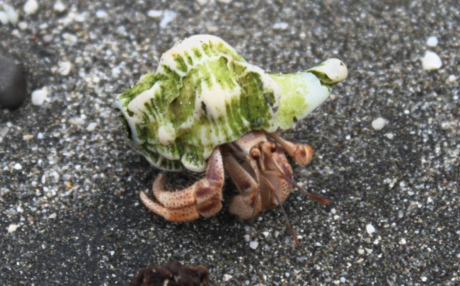
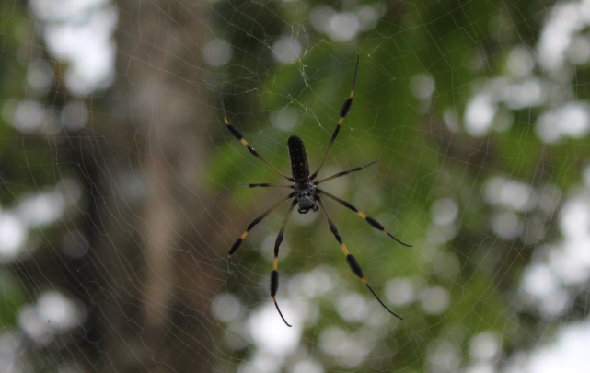
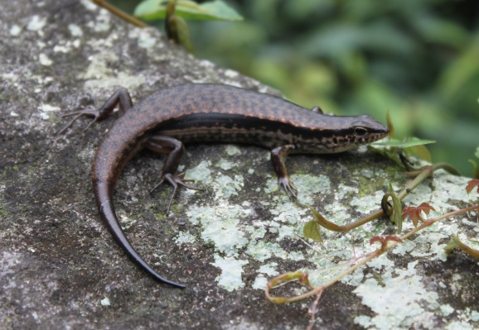
IUCN Red List Criteria: brief overview
Five criteria are used, because:
  number of factors contribute to extinction risk
  not all criteria are appropriate to all taxa
  e.g. population data may be available for large vertebrates, but not for smaller taxa/invertebrates
Meeting any one of the criteria qualifies a taxon for listing at that level of threat
Notes:
How are the criteria set up and structured? And why are there five different criteria?

Slide 14
IUCN Red List Criteria: brief overview
Criteria relate to factors which heighten the extinction risk of a species:
CRITERIA
THREATENED CATEGORIES
A
Population reduction
B
Restricted geographic range
Critically Endangered (CR)
C
Small population size & decline
Quantitative thresholds
Endangered (EN)
Very small or restricted population
Vulnerable (VU)
D
E
Quantitative analysis

Slide 15
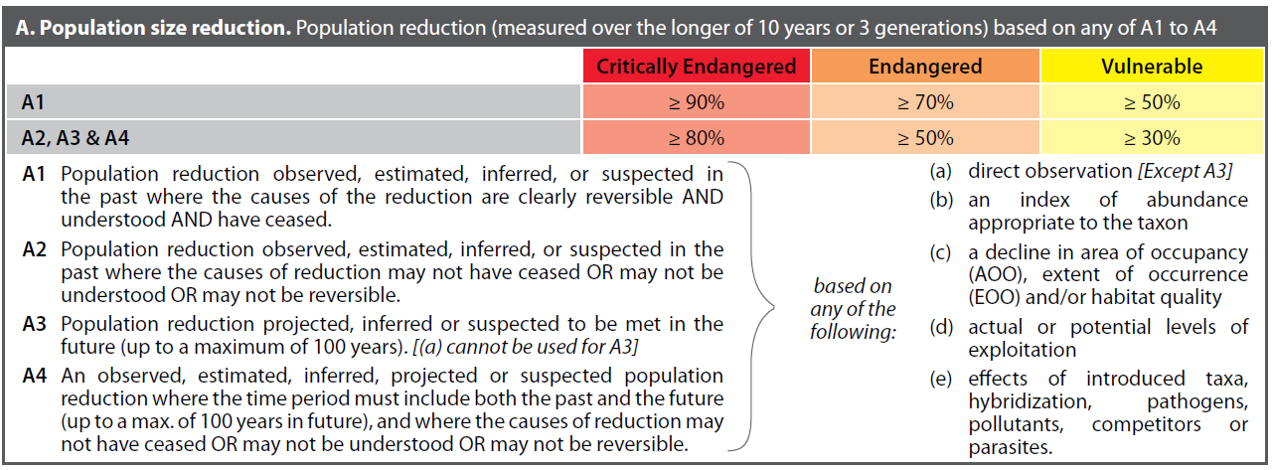
IUCN Red List Criteria: brief overview
Five criteria account for:
Population reduction (past, present or future)
Restricted geographic range and fragmentation, decline or extreme fluctuations
Small population size and decline
Very small or restricted populations
Estimated extinction risk from quantitative analysis (very rare!)
Notes:
To summarise again, the five criteria account for a number of different factors which heighten extinction risk – GO THROUGH LIST
For these criteria, thresholds are given for the threatened categories, for example, here an example of these thresholds for criterion A.

Slide 16




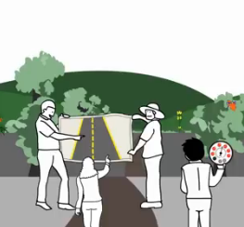

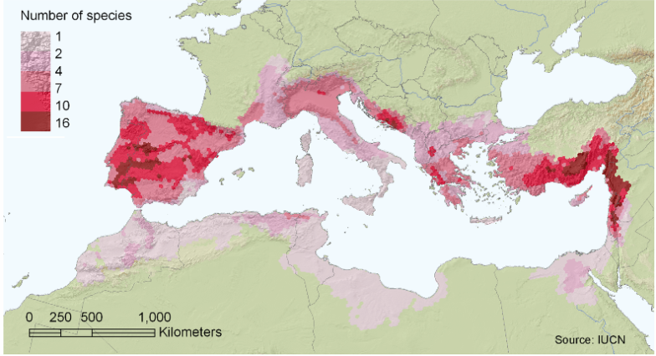
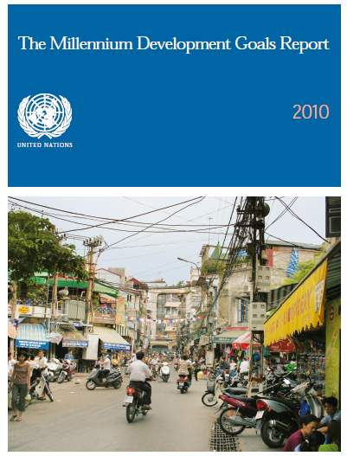
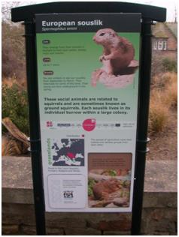
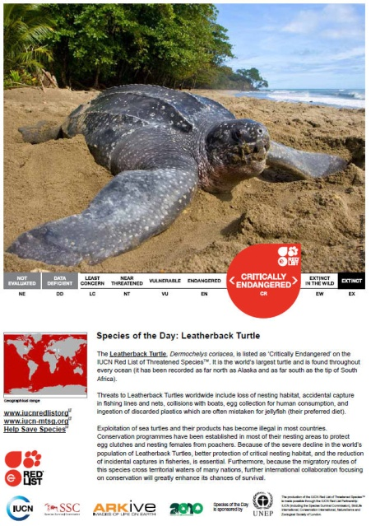

IUCN Red List – why?
Analysis and information
Conservation planning and priority-setting
International conservation policy
Influencing funding allocations
Private sector decision-making
Education and public awareness
Notes:
So, why are Red Lists important, how can they help us address the biodiversity crisis?

Slide 17
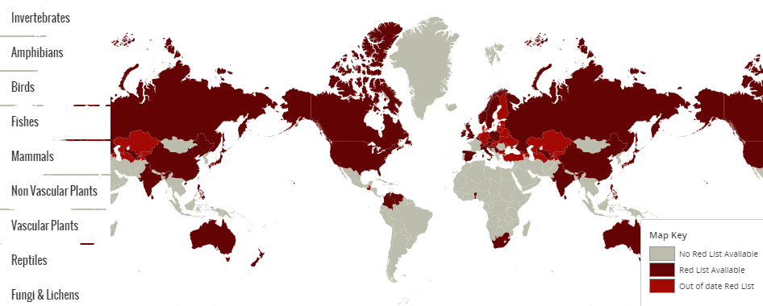
Why National Red Lists?
Decision making occurs at national or regional levels
Tools for:
Local, national or regional conservation planning
National-level biodiversity monitoring and biodiversity indicators
Measuring progress towards the CBD 2020 Aichi Targets
www.nationalredlist.org
Notes:
But: much of the decision making, particularly when it comes to conservation action and policy, priority setting, even raising awareness with the general public are activities carried out at the national or in some cases regional levels (e.g. for EU). Also, the reporting entity to the Convention on Biological Diversity (CBD) is the party, so countries which have signed up to the CBD, so they need to have mechanisms in place to be able to measure progress towards the CBD 2020 Aichi Targets, measure status and trends in biodiversity etc. And this is where National red Lists come in, they provide a powerful tool for conservation planning, monitoring of biodiversity at the national level, and measuring progress towards biodiversity targets. As well as the other points we have been through on the previous slide, communicating national-level biodiversity issues to the general public, prioritising conservation action, directing funding…

Slide 18
CBD & National Red Lists
Target 12: By 2020, the extinction of known threatened species has been prevented and their conservation status, particularly of those most in decline, has been improved and sustained.
Which species are threatened?
Targeted conservation action for species recovery
Red Lists (incl. National and Regional) + Action Plans
Notes:
How doe National Red Lists interact with targets set by the CBD? National Red Lists have the potential to contribute to at least 13 of the 20 targets set by the CBD. The most obvious of these is Target 12, so we use this here as an example.

Slide 19
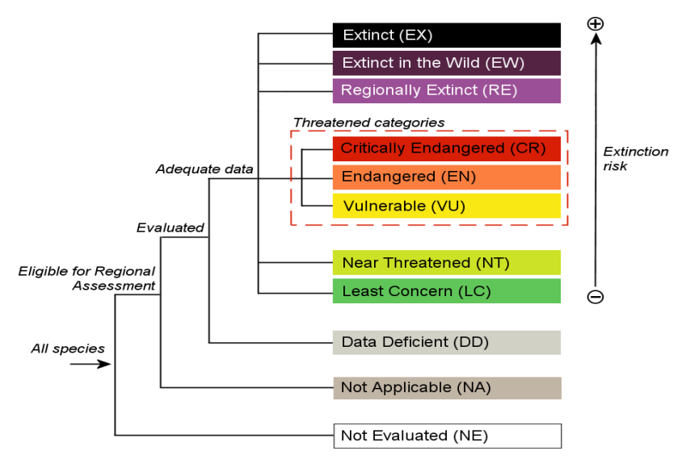
IUCN Red List Categories for NRLs
A taxon is Not Applicable if it is unsuitable for inclusion in the regional/national Red List, for example:
  Not a wild population
  Vagrant
  Low numbers in the region (a “filter” can be applied by National Red List authority)
Notes:
IUCN Red List Categories and Criteria have been adapted to allow usage at regional and national levels. In terms of the categories, two additional categories have been created for national level assessments, Regionally Extinct and Not Applicable.

Slide 20
Assessing at national level
Pop 1
Pop 3
STEP 1:
Assess species within national boundaries only
(ignore other populations)
STEP 2:
Consider effect of populations outside national boundaries
Rescue effects?
Pop 2
Standardised assessment across regions:
Helps with assessing status of populations outside the national range
Notes:
Rescue effect or source-sink population effects

Slide 21
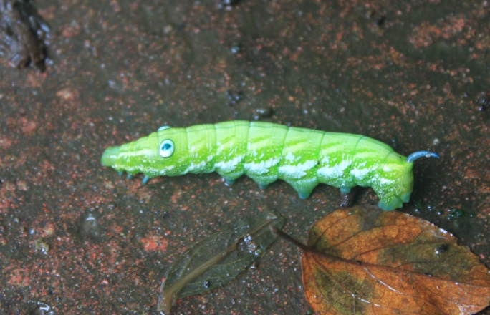
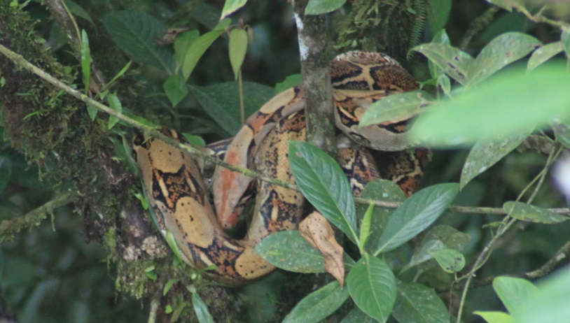
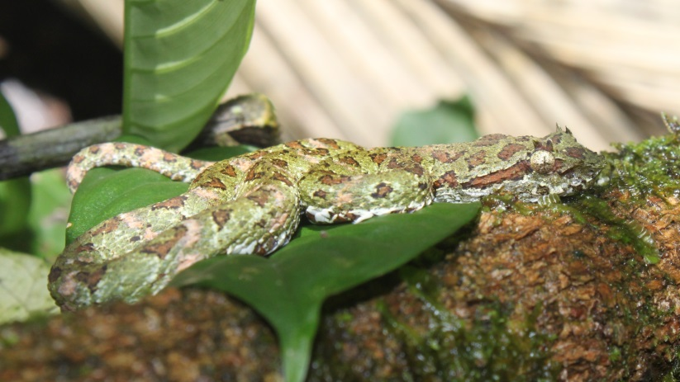
Advantages of using IUCN standards
Most widely used system for assessments of species status
Assessments are comparable across regions/countries
  Reliance on the same data types, e.g. occurrence records
  Helps with assessing status of populations outside the national range
  Introduces consistency & helps build global picture of species status
Facilitates inclusion of assessments onto IUCN Red List
Achieving harmonization of Red Lists – e.g. Europe
Notes:
e.g. Germany used non-IUCN system – most recent list is using a nationally developed system. Other countries, e.g Czech Republic has used a modified IUCN system

Slide 22
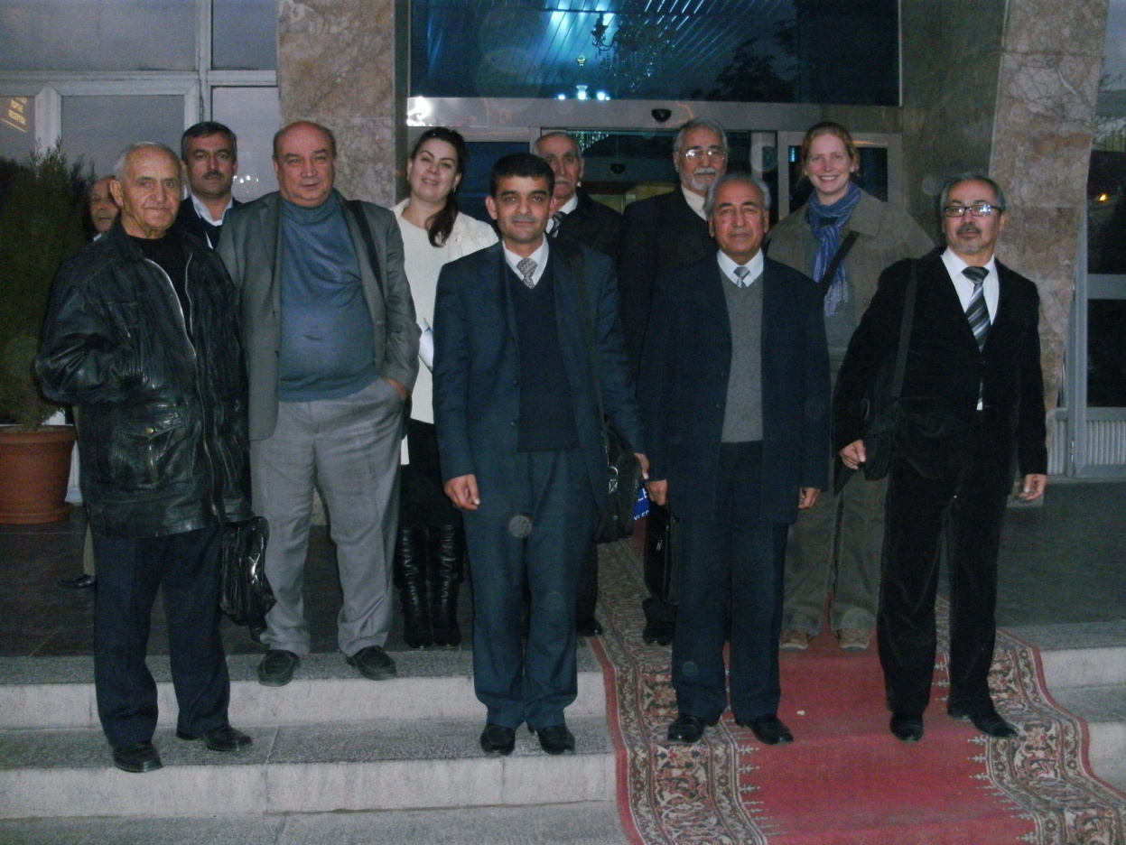


National Red List coverage
  122 countries have national lists (77 use the IUCN system) (Zamin et al. 2010 Cons. Biol.)
  Criteria systems used by current data:
  IUCN Categories and Criteria: 70%
  Modified-IUCN: 7%
  Non-IUCN: 23%
  (National Red List database, 12/08/14)
These statistics are currently being updated
National Red List workshop, Dushanbe (TJK), November 2010
Notes:
How important are national red lists globally? 122 countries have national lists (77 use the IUCN system) (based on Zamin et al. 2010 Cons. Biol.) These data are currently updated, following a call from the CBD to parties to submit information about their national Red Lists. Updated numbers will be available later this year on the National Red List website. On this website, we also have a searchable species database, holding around 100,000 species assessments at the moment (representing 76 countries and regions), of which 70% use IUCN Cats and Crits, 7% Modified IUCN criteria and 23% non-IUCN. Again, these statistics are currently being updated following a long update of our species database which has added around 30,000 species assessments already since the start of the year.

Slide 23
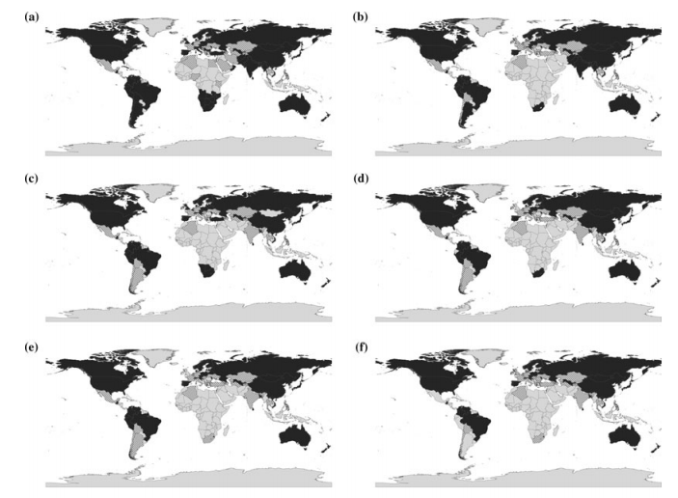
National Red List coverage
At least 1 NRL
Mammals
Birds
Amphibians
Reptiles
Fishes
  (Zamin et al. 2010 Cons. Biol.)
Notes:
Here an idea of the coverage of NRLs across the globe. Dark countries are those with an up-to-date NRL in 2010, grey those with an out of date Red List (> 10 years old) and light grey those without a NRL. More up-to-date coverage of NRLs can be found on the National Red List website, by different species groups. These are currently being updated

Slide 24
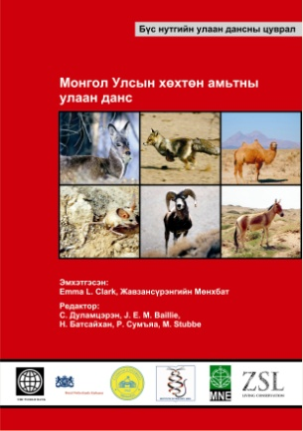
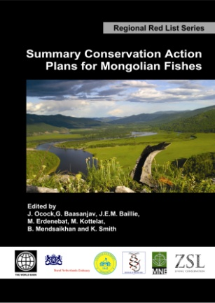
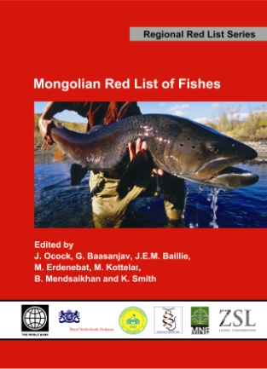
Mongolian National Red List
First country in Asia to have produced regional Red Lists of all their vertebrate species
Summary Conservation Action Plans
Mongolian Biodiversity Databank established
Initiated by Zoological Society of London:
  Steppe Forward (managing)
  Dutch Government, World Bank (funders)
  Mongolian Ornithological Society, National University of Mongolia, Mongolian Academy of Science and the Ministry of Nature, Environment and Tourism (collaborators)

Slide 25
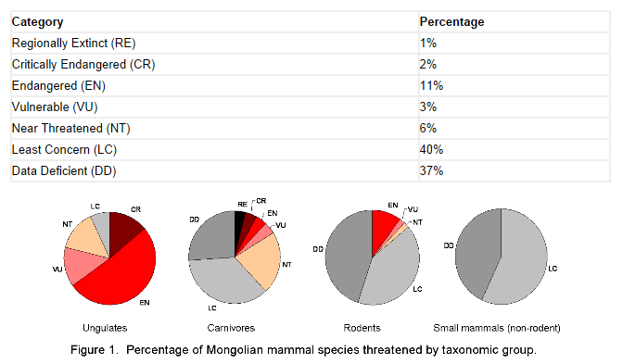
Mongolian National Red List
Mammals

Slide 26
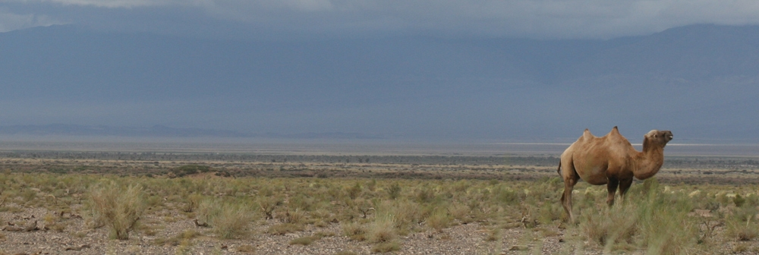
Translating NRLs into legislation
Many examples from Scandinavian countries where this has ben successfully achieved
Example Mongolia:
  Species protection of the Mongolian designated species
  Environmental Impact Assessments now required prior to mining development
  Based on spatial information about species occurrence
Notes:
Many examples from Scandinavian countries where this has ben successfully achieved, but I feel that our Finnish colleagues are much better equipped to talk about this in the following presentations. So again, I will be focussing on Mongolia, a country rich in natural resources

Slide 27

Species mapping tool for Mongolia
Notes:
Species mapping tool, interactive, you click on the area you are interested in and retrieve a list of species which occur there and their status. So you can see where the threatened protected species are. Plan is to integrate these data with additional data layers which are important for spatial planning and make the tool more complex

Slide 28

National RLIs to track trends
Red List Index at sub-global level
IUCN Red List Index of Species Survival
Based on birds in British Columbia (Quayle et al. 2008 Conservation Biology)
Notes:
And so to finish, I would like to close the circle and return to the idea of tracking changes in species over time. At the start of this talk we spoke about the Red List Index. This can also be applied at the National or regional level and allows changes in extinction risk status to be tracked over time. Here an example from British Columbia for birds, other examples exist, again specifically for Scandinavian countries which have a long history of applying the IUCN Categories and Criteria at the national level. Of course what this requires is at least two assessments of species over time following the IUCN Red List Cats and Crits system.

Slide 29
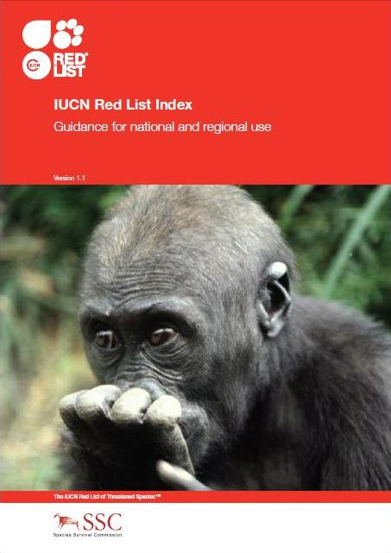
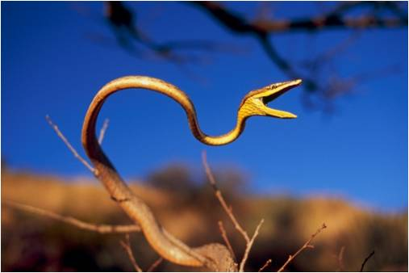
Re-visit: why National Red Lists?
Monitor status of biodiversity in the region
Identify priority species & habitats
Identify knowledge gaps
Assist in site-based conservation planning
Communication & awareness raising
Provide species inputs for environmental impact assessment
Help guide allocation of resources for biodiversity conservation
Support policy development

Slide 30
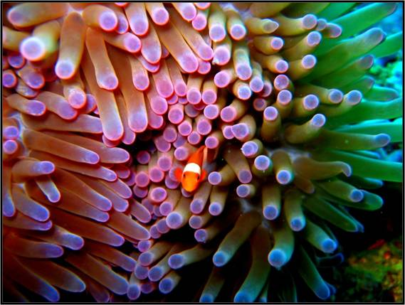
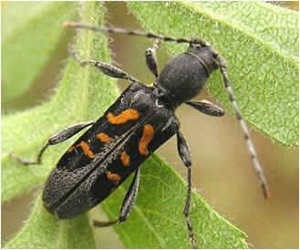
Re-visit: why IUCN Cats & Crits?
Most widely used system for assessments of species status
Assessments are consistent/comparable across regions/countries
Based on comparable data
Helps with assessing status of populations outside the national range & across regions
Facilitates inclusion of assessments onto IUCN Red List
Guidance and support available
Sharing of experiences and knowledge

Slide 31
National Red List Alliance & website
National Red List Alliance:
  established in 2013 to promote National Red listing
  help countries monitor their progress towards achieving Millennium Development Goal 7 and the Aichi Biodiversity Targets (particularly target 12)
National Red List website & database:
  Assessment resources and help
  Case studies
  Repository for national and regional assessments
  In future, better integration with the IUCN Red List
  www.nationalredlist.org
Notes:
The National Red List Alliance and the National Red List project were set up to provide advice, help and support and to promote the establishment of National Red Lists

Slide 32

























Acknowledgements

